Slide 1
Artificial Meat
Santosh Suwal, HaoNan Ou, Zhiqiang Wang, Bethold Owusu

Slide 2
Motivation
find out how people are familiar with artificial meat
observe factors that could influence the trend of artificial meat

Slide 3
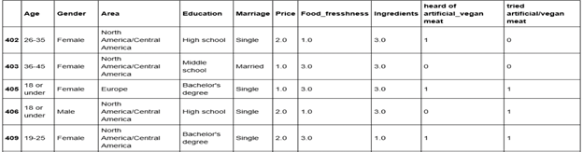
Data
Since our goal is to Investigate the impact of Artificial meat in our society:
-We conducted a survey online and obtained 409 responses
-Categorical Data

Slide 4
Research Questions
Do age and gender affect people's purchase of artificial meat?
What's the difference between married and single people in terms of price, food freshness and ingredient labels?
Whether they have heard about artificial meat, if there is a choice, how likely are people willing to try artificial meat for the first time or again?
How does location affect people's hearing and try artificial meat?

Slide 5
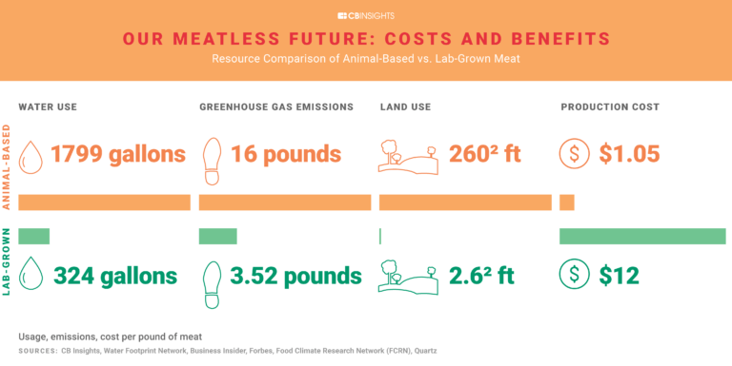
Related Works/ Contribution
Impact of artificial meat on Global Meat Market Industry
Meat industry reaches up to $1.8 Trillion Globally
The six largest meat companies totaled $60 billion
Resources Difference between artificial meat and real meat
Water use
Greenhouse gas emissions
Land use

Slide 6
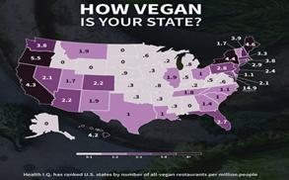
Related Works/ Contribution
Impact of Vegetarian in the US
divide the number of vegetarian restaurants in each state by the population of each state to get the number of all-vegetarian restaurants per million people
use the color bar to rank the number of vegetarian restaurants in each state
the number of vegetarian restaurants increased significantly from 2005 to 2015
compare to our data, we create similar maps to better understand whether the geographical environment will affect people's consumption of artificial meat.

Slide 7
Table of Task Lines and Findings
Member | Visualization | Interesting Findings
Bethold Owusu | Interactive Pyramidal Bars and P-values | More singles tried and heard of Artificial Meat compared to Married ones
Santosh Suwal | Circle Packing | Over half of people who hadn’t tried artificial meat are willing to try
HaoNan | Interactive and Selective Bar Charts | Teenagers and females tried artificial meat compared old and males
Zhiqiang Wang | Selective Geographical Map | Bias from location responses (Mostly North America)

Slide 8
Visualization Types
Histogram
compares distributions among different groups
Circle Packing
shows different relationships between the answers
Bar Chart
computes features relatedness and their p-values
Global map
shows density by continent down to locality

Slide 9
Link to the Website
https://bit.ly/2M77D6D

Slide 10
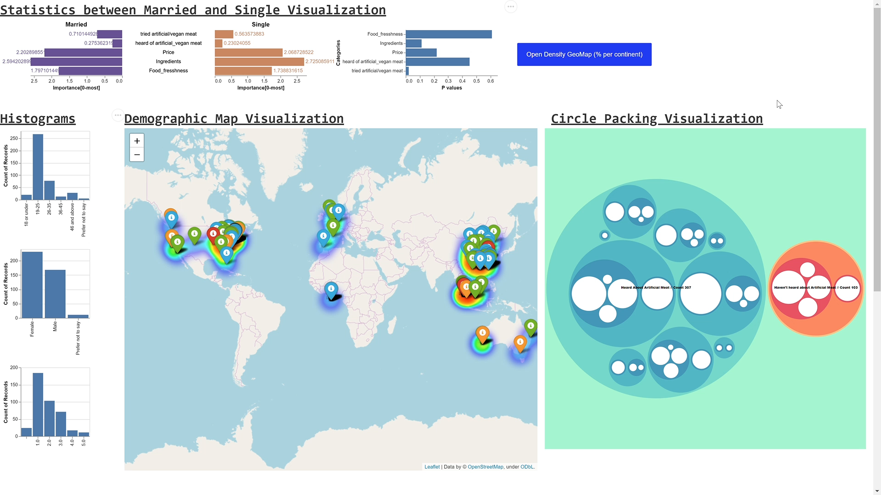
Video

Slide 11
Summary
family and friends were one of the strongest factors that determined if the surveyor wanted to try artificial meat.
As the market for artificial meat expands, there is a high possibility that artificial meat will become the meat of the future as consumers continue to express an interest in health and in artificial/vegan meat products.

Slide 12
REFERENCES
The Health IQ Team, How VEGAN IS YOUR STATE?, 2015,
https://www.healthiq.com/blog/vegan-restaurants-by-state/
CB INSIGHTS, Our Meatless Future: How The $1.8T Global Meat Market Get Disrupted,
Novemeber 13, 2019,
https://www.cbinsights.com/research/future-of-meat-industrial-farming/

